Slide 1


IMRANA BELLO
16/06/2025

Slide 2
Outline
Executive Summary
Introduction
Methodology
Results
Conclusion
2

Slide 3
Executive Summary
In this capstone project, we will predict if the SpaceX Falcon 9 first stage will land
successfully using several machine learning classification algorithms.
The main steps in this project include:
Data collection, wrangling, and formatting
Exploratory data analysis
Interactive data visualization
Machine learning prediction •
Our graphs show that some features of the rocket launches have a correlation
with the outcome of the launches, i.e., success or failure.
It is also concluded that decision tree may be the best machine learning algorithm to predict if the Falcon 9 first stage will land successfully.
3

Slide 4
Introduction
In this capstone, we will predict if the Falcon 9 first stage will land successfully. SpaceX advertises Falcon 9 rocket launches on its website with a cost of 62 million dollars; other providers cost upward of 165 million dollars each, much of the savings is because SpaceX can reuse the first stage. Therefore if we can determine if the first stage will land, we can determine the cost of a launch. This information can be used if an alternate company wants to bid against SpaceX for a rocket launch.
Most unsuccessful landings are planned. Sometimes, SpaceX will perform a controlled landing in the ocean.
The main question that we are trying to answer is, for a given set of features about a Falcon 9 rocket launch which include its payload mass, orbit type, launch site, and so on, will the first stage of the rocket land successfully?
4

Slide 5

Section 1
5

Slide 6
Methodology
Executive Summary
Data collection methodology:
Web scraped from web
Perform data wrangling
Python Environment
Perform exploratory data analysis (EDA) using visualization and SQL
Perform interactive visual analytics using Folium and Plotly Dash
Perform predictive analysis using classification models
Logistic Regression
Support Vector Machine
Decision Tree
6
•
K-nearest neighbors(KNN)

Slide 7
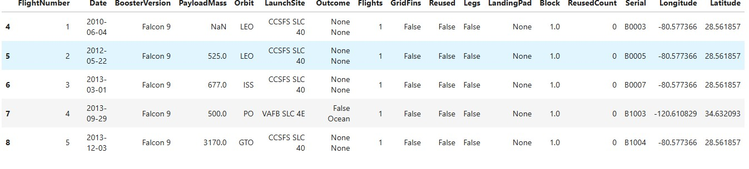
Data Collection
The data was collected and scraped using Beautiful Soup. The link of the dataset
https://en.wikipedia.org/wiki/List_of_Falcon_9_and_Falcon_Heavy_launches
The website was tailored to contain data about Falcon9 launch.
It contains 90 rows and 17 columns.
7

Slide 8
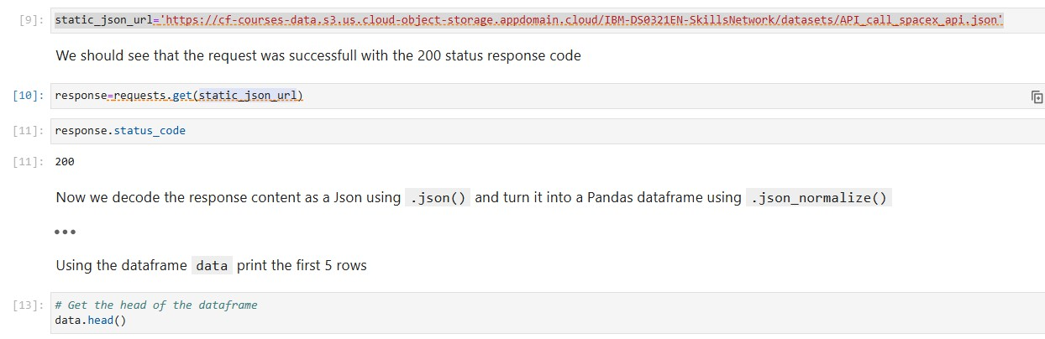
Data Collection – SpaceX API
The flowchart to the API is shown.
The Github link to the project https://github.com/Nnaemeka13/D ata-Science-Capstone-Project.git
8

Slide 9
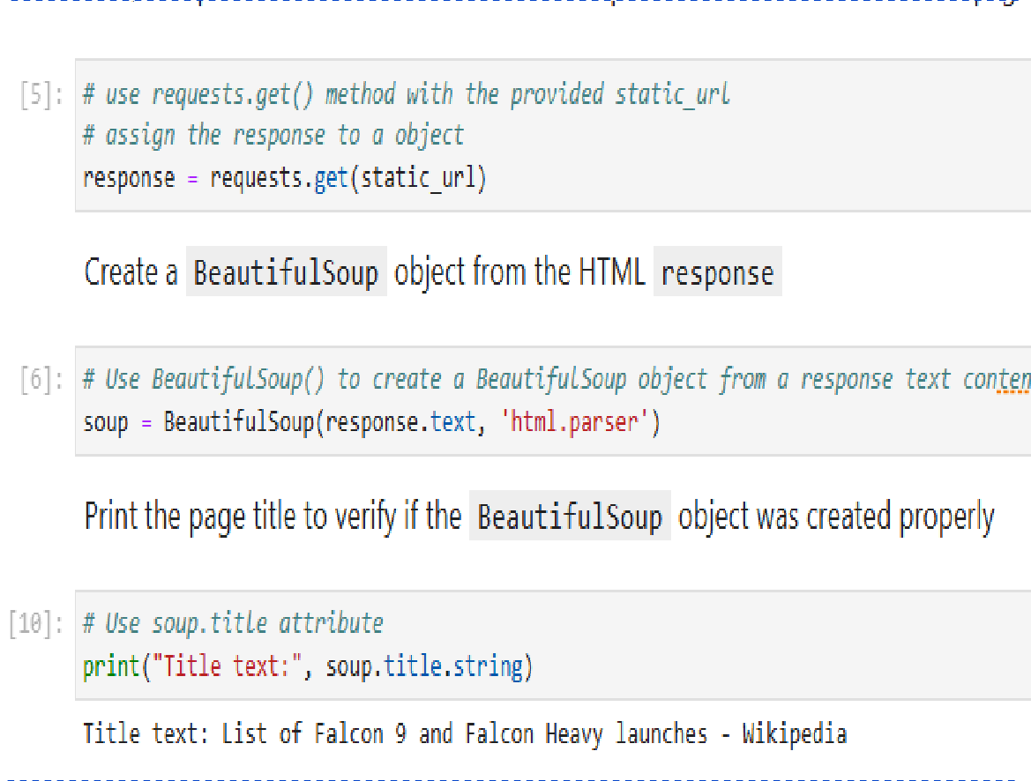
Data Collection - Scraping
The code for parsing the data using BeautifulSoup is shown.
The github URL : https://github.com/Nnaemek a13/Data-Science-Capstone- Project/blob/main/jupyter- labs-webscraping.ipynb
Place your flowchart of web scraping hee
9

Slide 10
Data Wrangling
The data is later processed so that there are no missing entries and categorical features are encoded using one-hot encoding.
An extra column called ‘Class’ is also added to the data frame. The column ‘Class’ contains 0 if a given launch is failed and 1 if it is successful.
In the end, we end up with 90 rows or instances and 83
columns or features.
10

Slide 11

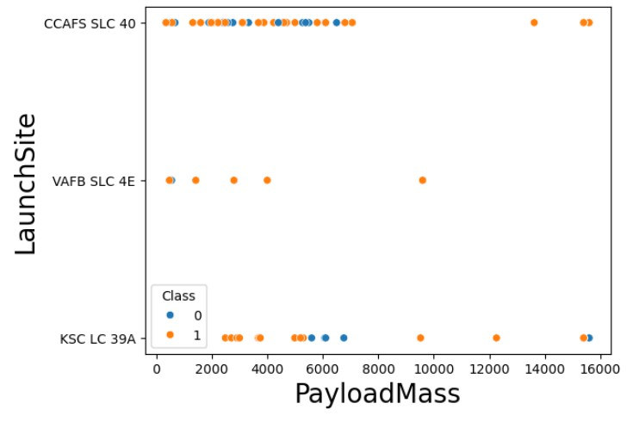
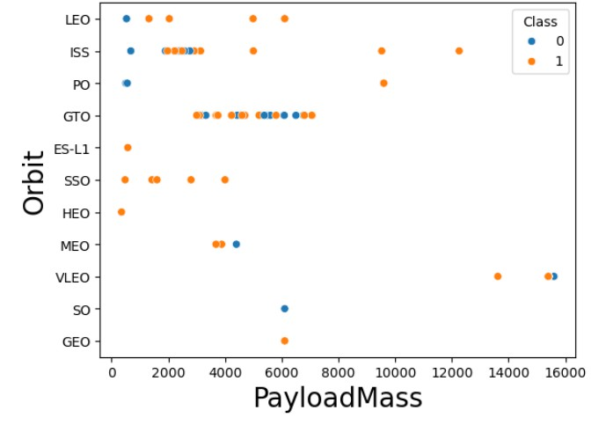
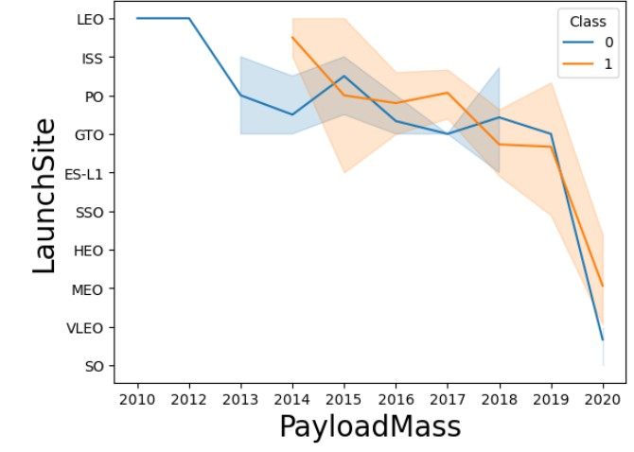
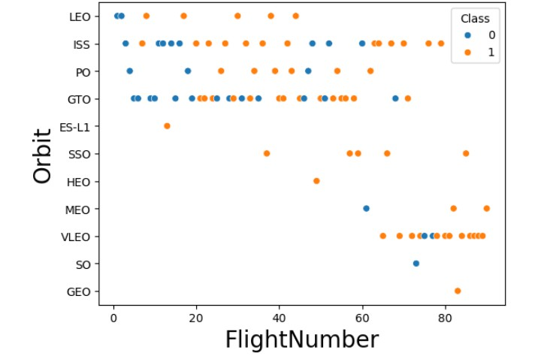
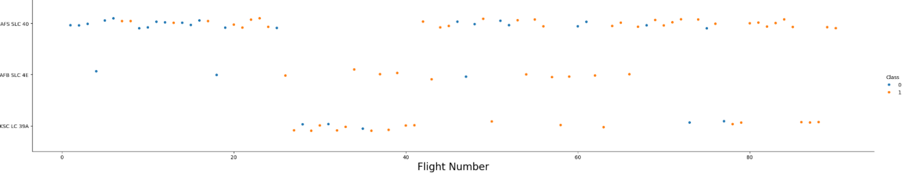
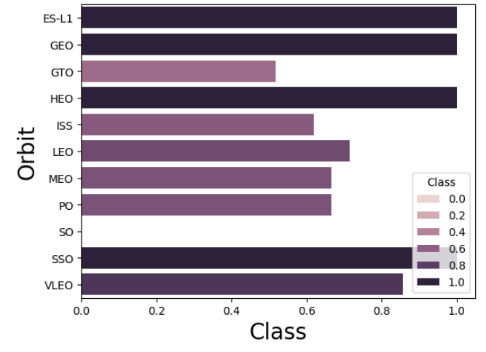
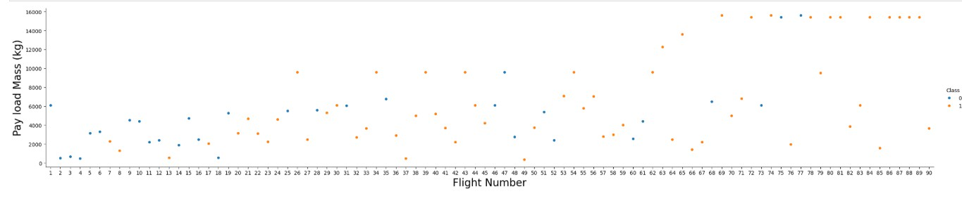
EDA with VISUALIZATION
11

Slide 12
EDA with SQL
Pandas and NumPy
Functions from the Pandas and NumPy libraries are used to derive basic information about the data collected, which includes:
The number of launches on each launch site
The number of occurrence of each orbit
The number and occurrence of each mission outcome
SQL
The data is queried using SQL to answer several questions about the data such as:
The names of the unique launch sites in the space mission
The total payload mass carried by boosters launched by NASA (CRS)
The average payload mass carried by booster version F9 v1.1
List the date when the first successful landing outcome in ground pad was achieved
Rank the count of landing outcomes (such as Failure (drone ship) or Success (ground pad)) between the date 2010-06-04 and 2017-03- 20, in descending order.
https://github.com/Nnaemeka13/Data-Science-Capstone-Project/blob/main/jupyter-labs-eda-sql-coursera_sqllite.ipynb
12

Slide 13
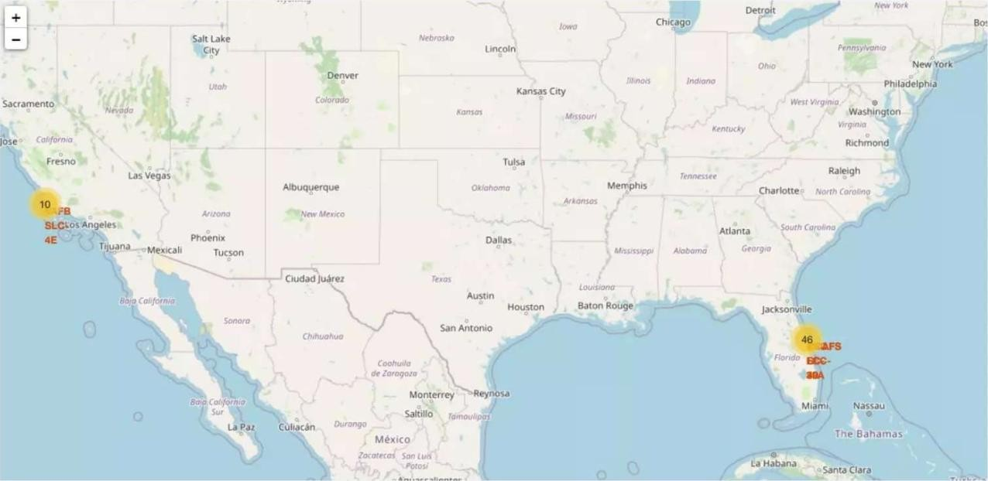
Build an Interactive Map with Folium
https://github.com/Nnaemeka13/Data-Science-Capstone-Project.git

Slide 14
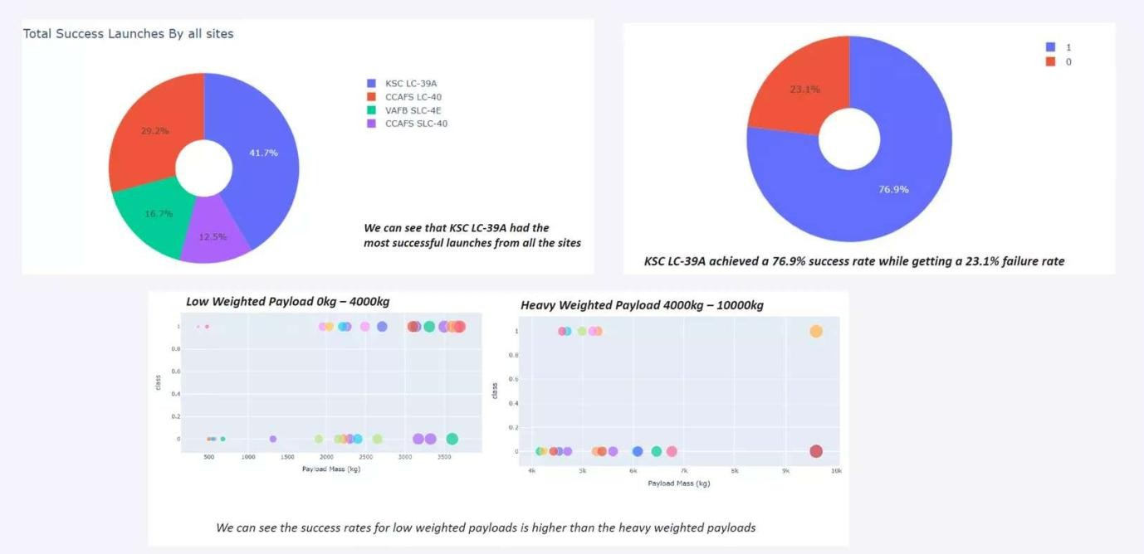
Build a Dashboard with Plotly Dash
https://github.com/Nnaemeka13/Data-Science-Capstone-Project.git

Slide 15
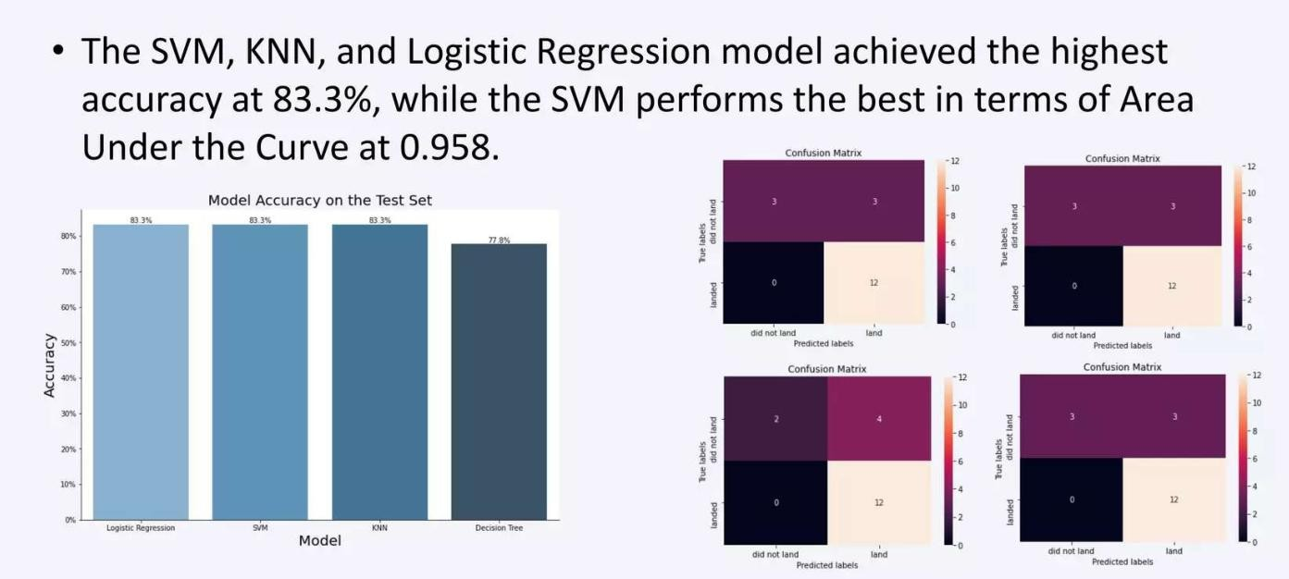
Predictive Analysis (Classification)
15

Slide 16
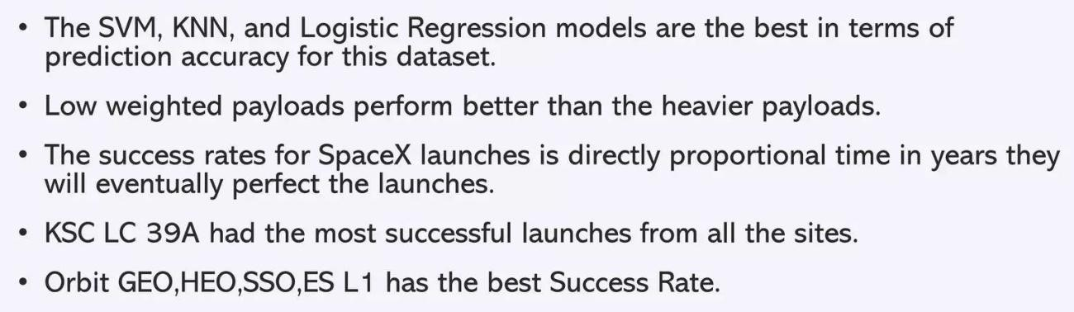
Results
16

Slide 17

Section 2

Slide 18
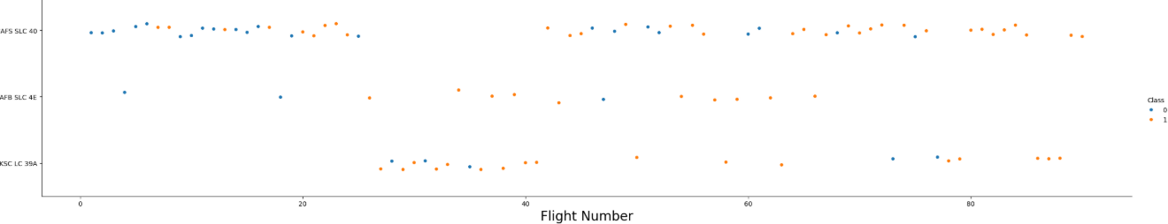
Flight Number vs. Launch Site
Show a scatter plot of Flight Number vs. Launch Site

Slide 19
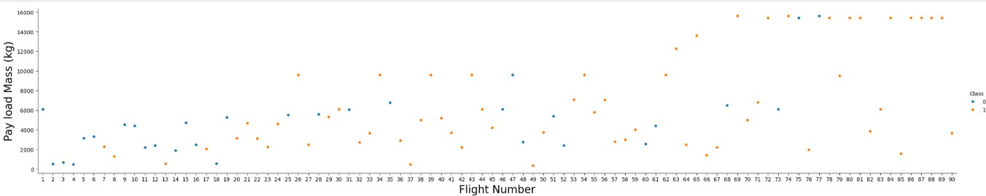
Payload vs. Launch Site
Show a scatter plot of Payload vs. Launch Site

Slide 20
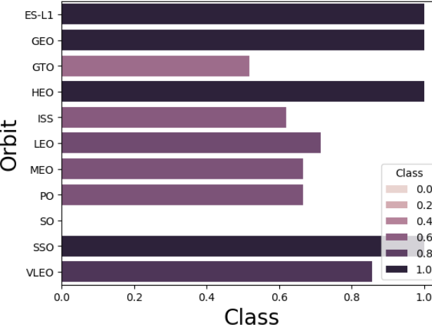
Success Rate vs. Orbit Type
Show a bar chart for the success rate of each orbit type
Show the screenshot of the scatter plot with explanations

Slide 21
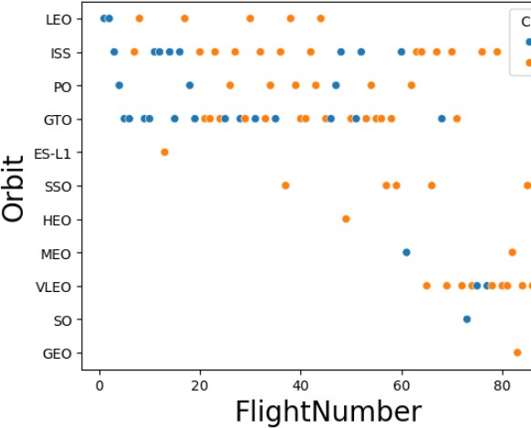
Flight Number vs. Orbit Type
Show a scatter point of Flight number vs. Orbit type
Show the screenshot of the scatter plot with explanations

Slide 22
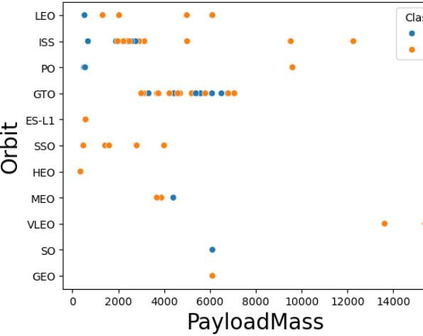
Payload vs. Orbit Type
Show a scatter point of payload vs. orbit type
Show the screenshot of the scatter plot with explanations

Slide 23

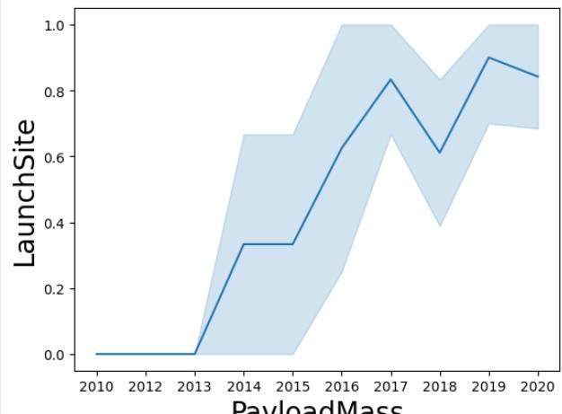
Launch Success Yearly Trend
Show a line chart of yearly average success rate
Show the screenshot of the scatter plot with explanations

Slide 24
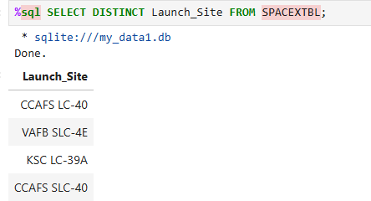
All Launch Site Names

Slide 25
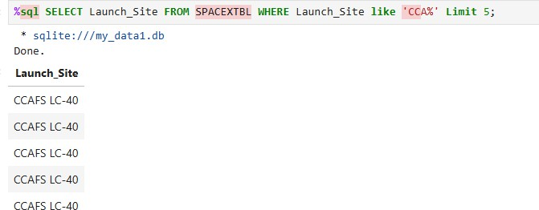
Launch Site Names Begin with 'CCA'

Slide 26
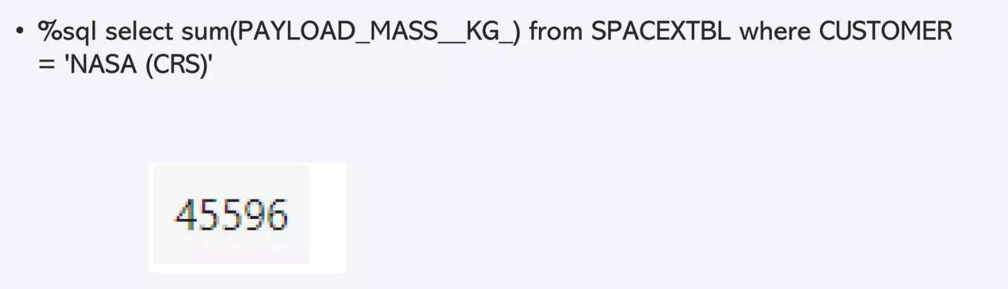
Total Payload Mass
26

Slide 27
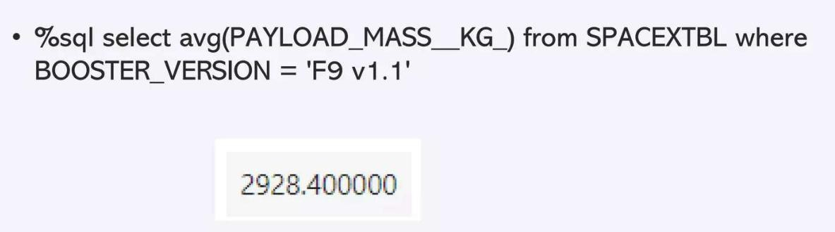
Average Payload Mass by F9 v1.1

Slide 28
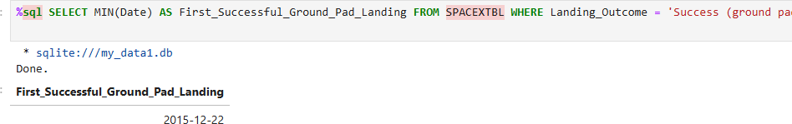
First Successful Ground Landing Date

Slide 29
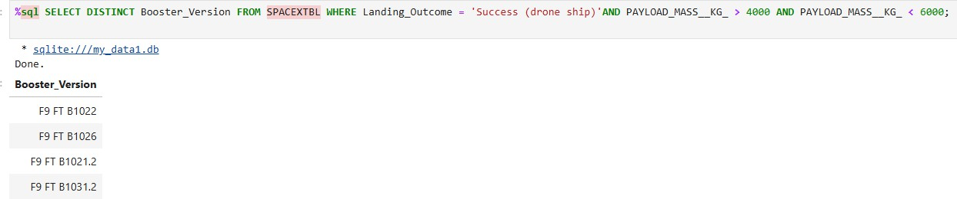
Successful Drone Ship Landing with Payload between 4000 and 6000

Slide 30
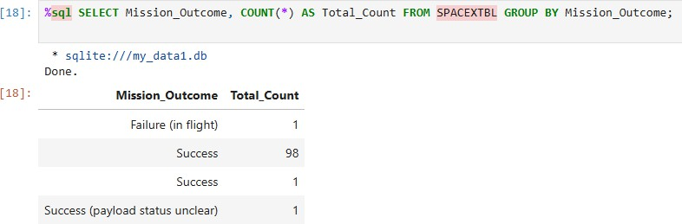
Total Number of Successful and Failure Mission Outcomes

Slide 31
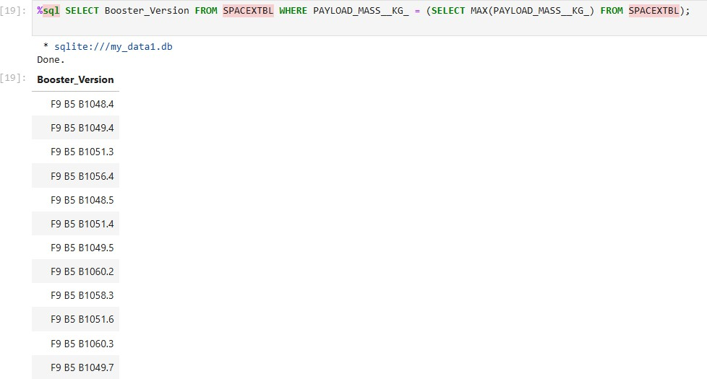
Boosters Carried Maximum Payload

Slide 32
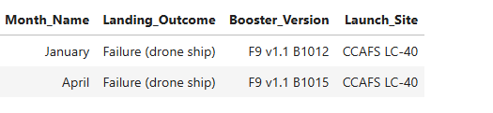
2015 Launch Records
32

Slide 33
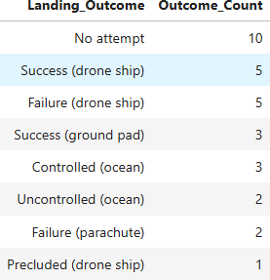
Rank Landing Outcomes Between 2010-06-04 and 2017-
03-20
33

Slide 34

Section 3

Slide 35
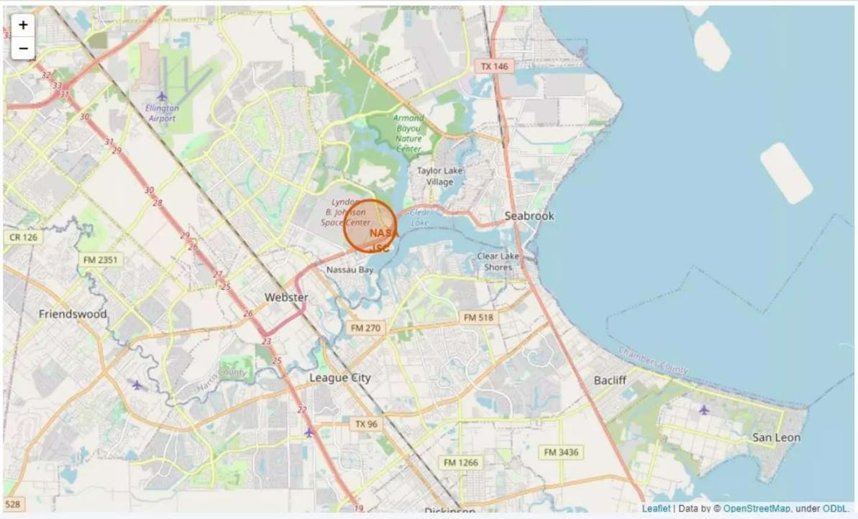
ALL MAPPED LAUNCH SITES

Slide 36
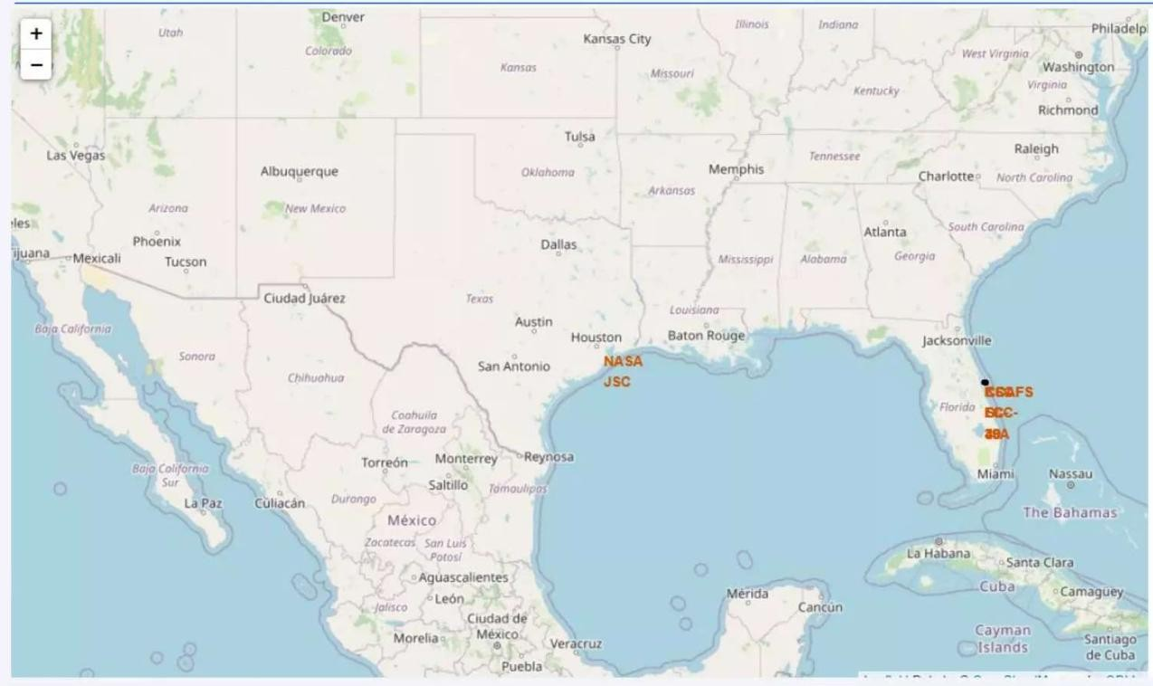
SUCCESS AND FAILED LAUNCHES MARKED

Slide 37
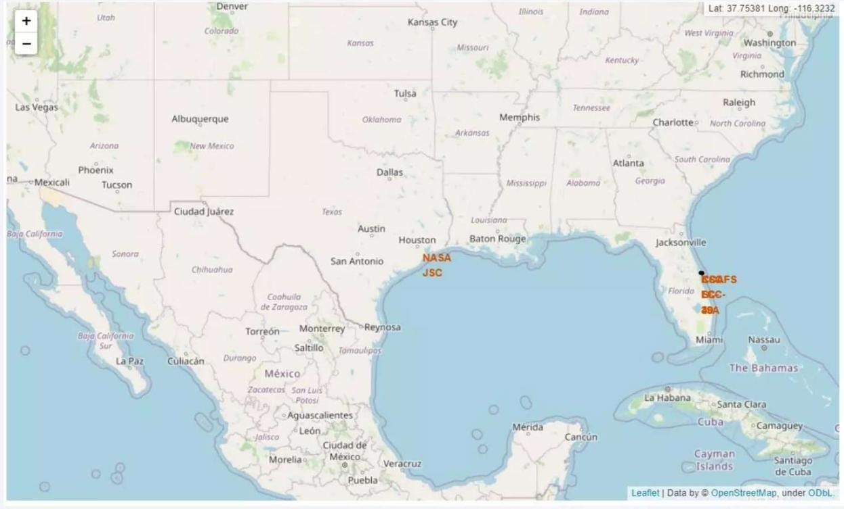
DISTANCE BETWEEN LAUNVH SITE AND ITS PROXIMITIES

Slide 38

Section 4

Slide 39
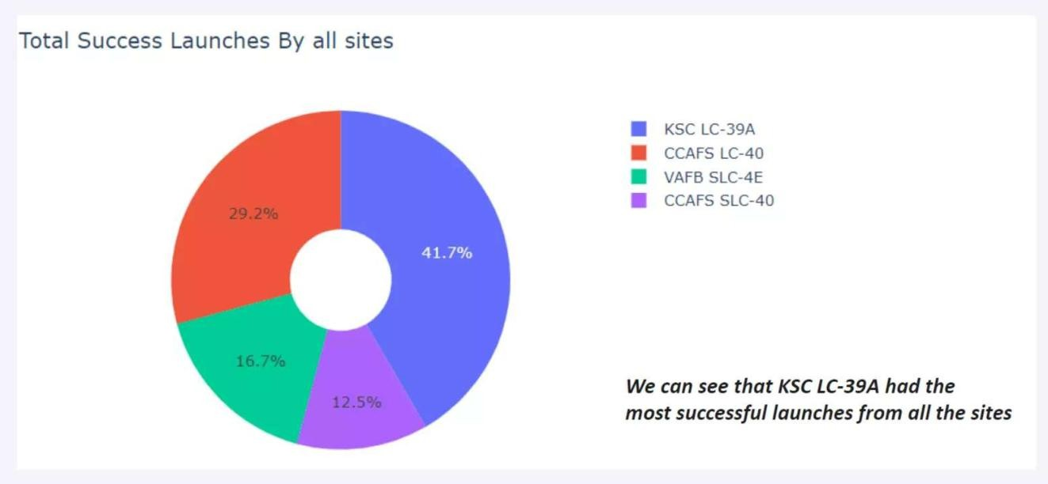
Total Success Launches By All Sites

Slide 40
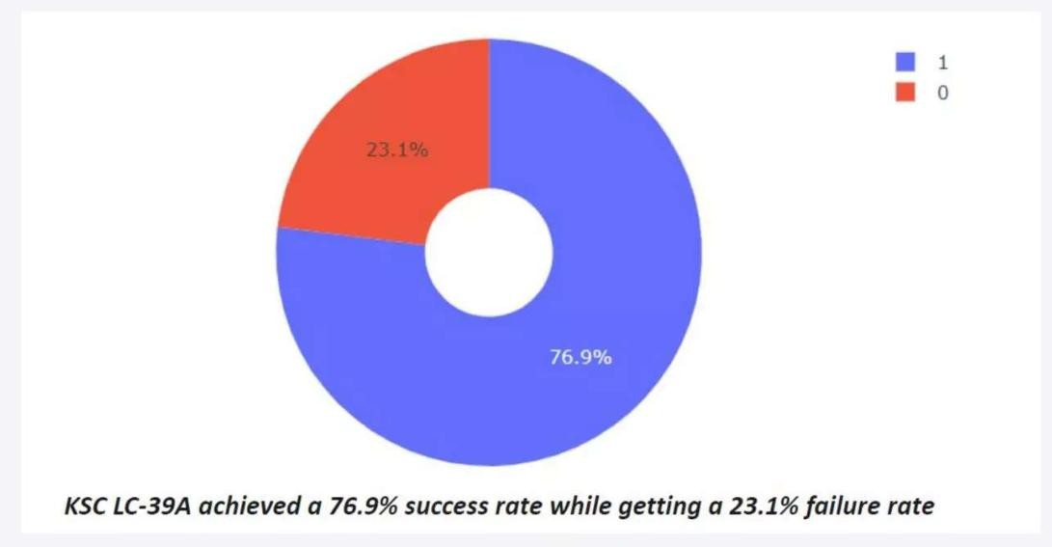
Success Rate By Class

Slide 41
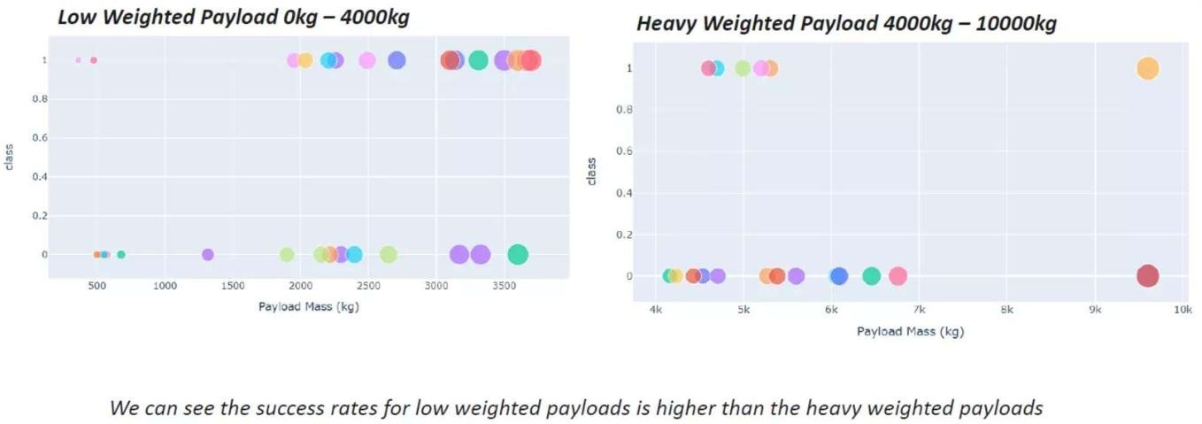
Payload Vs Launch Outcome

Slide 42

Section 5

Slide 43
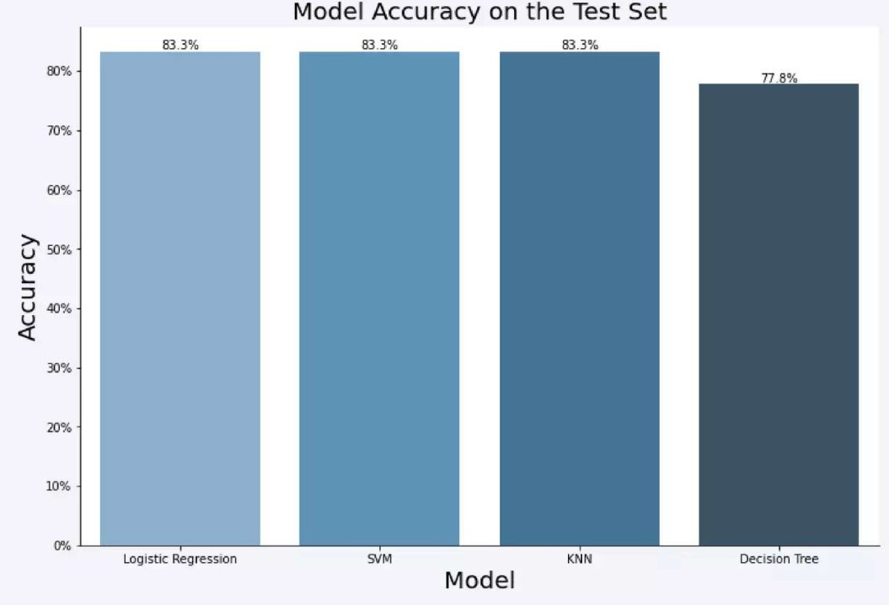
Classification Accuracy
43

Slide 44
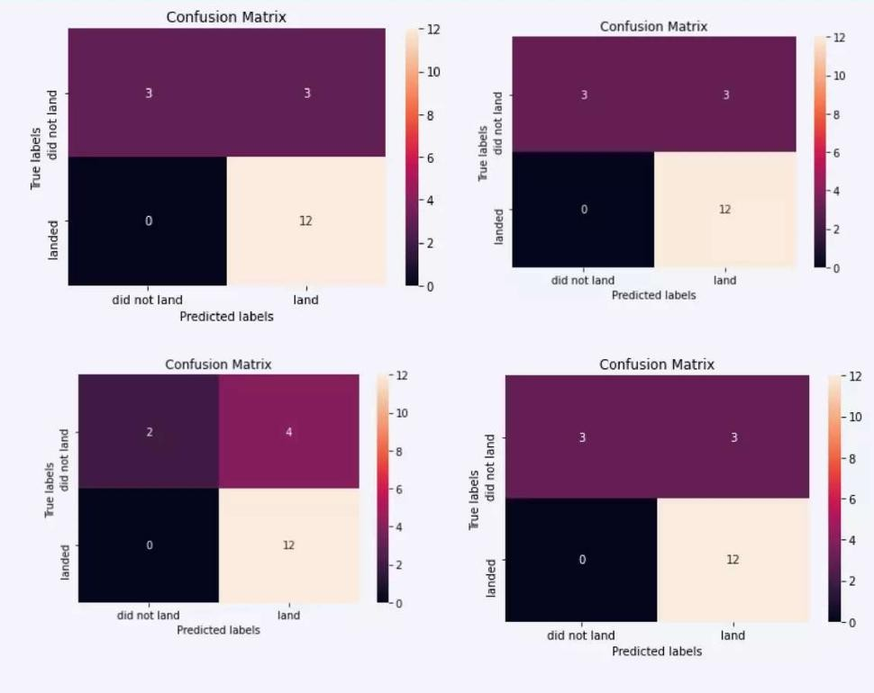
Confusion Matrix
44

Slide 45
Conclusions
Putting the results of all 4 models' side by side, we can see that they all share the same accuracy score and confusion matrix when tested on the test set.
Low weighted payloads performed better than the heavy weighted payload.
KSC LC 39A has the most successful launches from all the sites.
The predictive model produced by decision tree algorithm performed the best among the 4 machine learning algorithms employed
45

Slide 46


